Slide 1

MALLA REDDY COLLEGE OF ENGINEERING Maisammaguda, Dhullapally ,(Post Via Hakeem Pet), Secunderabad-500014 DEPARTMENT OF ELECTRONICS AND COMMUNICATION ENGINERING
MAJOR PROJECT REPORT ON
IOT BASED SMART AGRICULTURE MONITORING SYSTEM
2020-2024
Under the guidance of Mr.Dr.D.RAJESH
Assistant professor
PRESENTED BY:
B.SAI RAMYA 20Q91A0452
A.THARUN 20Q91A0454
B.NANDINI 20Q91A0422

Slide 2
INTRODUCTION
Brief overview of traditional agriculture challenges:
Traditional agriculture faces challenges like labor-intensive practices, over-exploitation of resources, lack of real-time monitoring, inefficient water management, and vulnerability to environmental changes, resulting in lower productivity and sustainability.
The need for smart and efficient farming practices:
To address resource constraints, environmental impacts, and food demands of a growing population, there is a pressing need for smart, data-driven, and efficient farming practices that optimize inputs and maximize yields.
The importance of IoT in modern agriculture:
IoT plays a crucial role in modern agriculture by enabling real-time monitoring of crop and soil conditions, automated irrigation systems, predictive analysis for pest and disease management, and precise application of inputs like water and fertilizers. IoT-based smart farming enhances productivity, reduces wastage of resources, and supports sustainable agricultural practices.

Slide 3
EXISTING SYSTEM
The existing method and one of the oldest ways in agriculture is the manual method of checking the parameters. In this method farmers they themselves verify all the parameters and calculate the reading.
Farmers used to guess the fertility of the soil and assumed to grow which type of crop. They didn’t know about the moisture, level of water, and particularly weather condition which terrifies a farmer more.
They use pesticides based on some assumptions which made leads to a serious effect on the crop if the assumption is wrong. The productivity depends on the final stage of the crop on which the farmer depends.

Slide 4
DRAWBACKS OF EXISTING SYSTEM
Productivity may or may not be more
We cannot estimate weather conditions as pollution is increasing gradually etc.
There is no proper crop protection.
No indication system for farmer.

Slide 5
PROPOSED SYSTEM
Monitoring agricultural environment for various factors such as temperature and humidity along with significance to protect the crops from environmental heavy rain, heavy sun rays, heavy chemical industries pollution's, and fire detection to the crop with help of sensors where farmer can get update of the field.
It focuses on developing devices and tool to manage, display and alert the users using the advantages of a wireless sensor network system. It aims at making agriculture smart using automation and IOT technologies.
It proposes a low cost and efficient wireless sensor network technique to acquire from different sensors. As per need of the crop controller to take decision whether the irrigation is enabled or not.

Slide 6
BLOCK DIAGRAM
ARDUINO
CONTROLLER
RPS
LCD
SOIL MOISTURE SENSOR
RELAY
IR SENSOR
AC WATER PUMP
WIFI MODULE

Slide 7
HARDWARE COMPONENTS USED
Soil Moisture Sensor
IR Sensor
16X2 LCD(Liquid Crystal Display)
Relay
WIFI Module
A.C Water pump

Slide 8
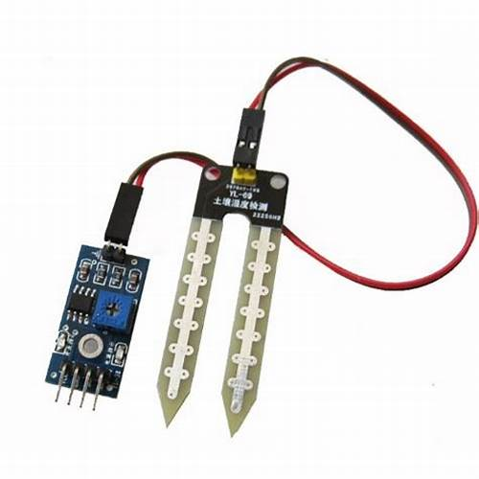
SOIL MOSITURE SENSOR
Soil moisture sensors may be wired or wireless. In smart agriculture systems, wireless sensors are often preferred for easy deployment and data collection. These sensors transmit data to a central control system or a cloud-based platform.
Soil moisture sensors are typically inserted into the ground at various depths, depending on the rooting depth of the crops. Probes or rods are commonly used to ensure proper contact with the soil.
The LM324 series consists of four independent, high gains; internally frequency compensated operational amplifiers which were designed specifically to operate from a single power supply over a wide range of voltages. Operation from split power supplies is also possible and the low power supply current drain is independent of the magnitude of the power supply voltage.

Slide 9
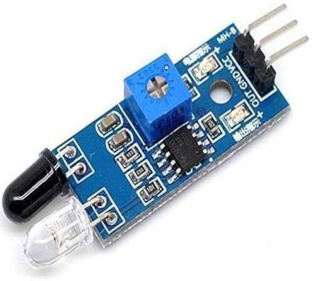
IR SENSOR
An electro-luminescent IR LED is a product which requires care in use. IR LED’s are fabricated from narrow band hetero structures with energy gap from 0.25 to 0.4 eV. Infra red transmitter emits IR rays in planar wave front manner.
Even though infrared rays spread in all directions, it propagates along straight line in forward direction.
An IR (Infrared) sensor is used to detect obstacles or objects by emitting infrared radiation and measuring the reflected radiation.
In the smart agriculture system, IR sensors are employed to detect the presence of crops or vegetation in the field. This information can be used for automated irrigation scheduling or to monitor crop growth and health.

Slide 10
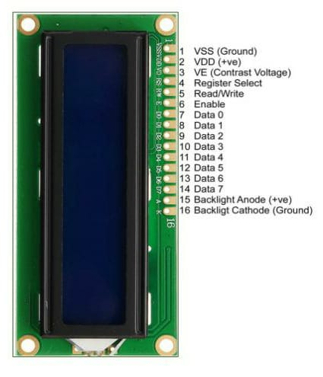
16 X 2 LIQUID CRYSTAL DISPLAY
Out of all available LCD modules in market, the most commonly used one is 16×2 LCD Module which can display 32 ASCII characters in 2 lines.
This module provides an efficient solution for conveying information in a compact and organized manner.
They are known for their thin profile, lightweight design, and ability to provide sharp and vibrant visuals, making them widely used in consumer electronics.

Slide 11
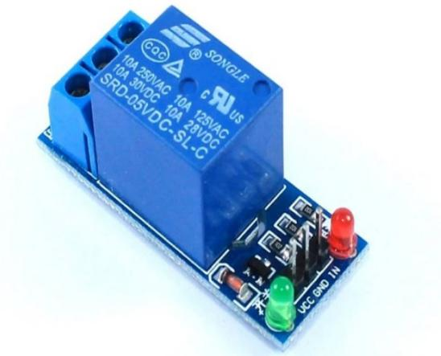
RELAY
A Relay is a simple electromechanical switch. While we use normal switches to close or open a circuit manually, a Relay is also a switch that connects or disconnects two circuits.
But instead of a manual operation, a relay uses an electrical signal to control an electromagnet, which in turn connects or disconnects another circuit

Slide 12
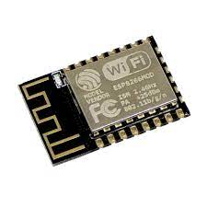
WIFI MODULE
Wi-Fi modules or Wi-Fi micro controllers are used to send and receive data over Wi-Fi. They can also accept commands over the Wi-Fi.
Wi-Fi modules are used for communications between devices. They are most commonly used in the field of Internet of Things.

Slide 13
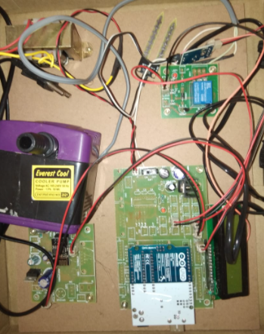
PROTOTYPE OF HARDWARE

Slide 14
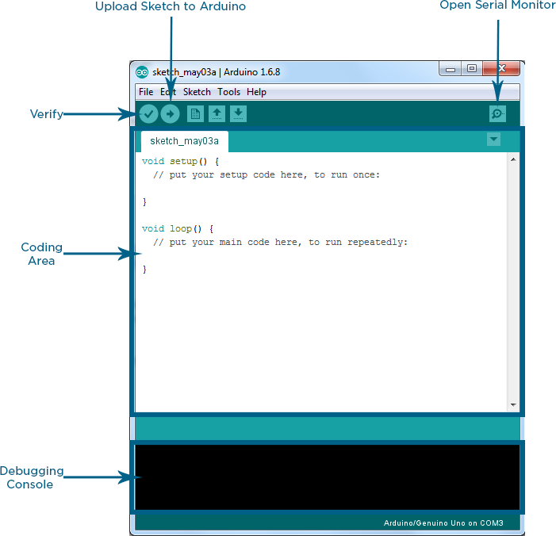
ARDUINO IDE
The Arduino Integrated Development Environment (IDE) is an open-source software designed by Arduino.cc that is used for writing, compiling, and uploading code to almost all Arduino modules. It connects to the Arduino hardware to upload programs and communicate with them. It supports languages like embedded C and C++ .
The Node MCU is loaded into the Arduino IDE via a loader program in the board's firmware using the program that the Arduino IDE uses to transform the executable code into a text file in hexadecimal encoding.

Slide 15
HARDWARE FUNCTIONALITY
1. Powering Up the Hardware:
Ensure the hardware is supplied with a 5V power source to initiate its functionality.
2. Network Connection Establishment:
Allow the hardware sufficient time to establish a connection to the local network, ensuring seamless communication.
3. Retrieving IP Address from LCD Display:
Observe the IP address displayed on the LCD screen, serving as the unique identifier for the hardware within the network.
4. Accessing Output via Mobile Telnet:
Using any web browser on a device connected to the same Wi-Fi network, visit the identified IP location to observe and interact with the hardware's output.

Slide 16
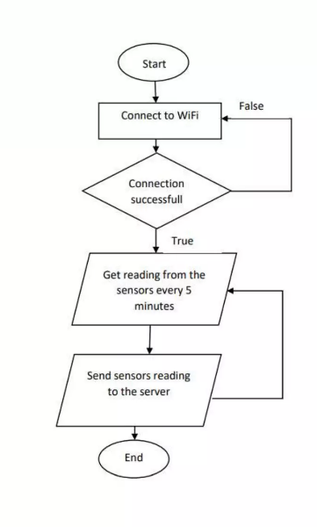
WORK FLOW

Slide 17
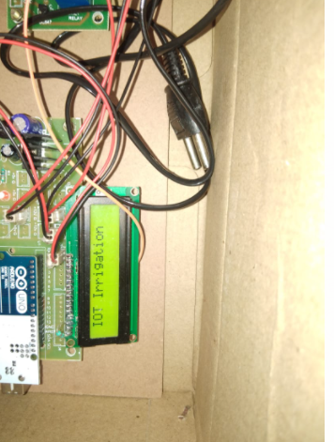
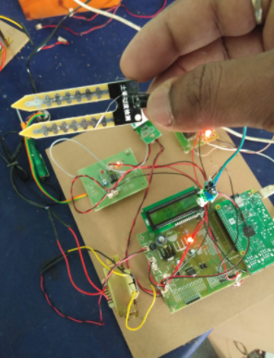
OUTPUT
Fig 1: IOT Irrigation Display
Fig 2: Soil Moisture Sensor

Slide 18
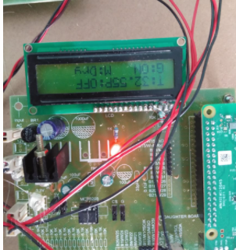
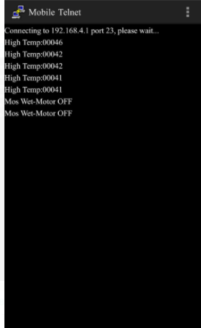
Fig 3: Displaying Input Prameters in LCD
Fig 4: Mobile Telnet Output Results

Slide 19
ADVANTAGES
Precision Farming
Real-Time Monitoring
Weather Forecasting Integration
Crop Monitoring and Management
Early Detection of Issues
Enhanced Sustainability

Slide 20
FUTURE SCOPE
Integration with Drones/UAVs : The system could be integrated with drone technology for aerial monitoring, precision spraying of pesticides/fertilizers, and high-resolution imagery for analysis.
Robotics and Automation :Robotic systems could be incorporated for tasks like autonomous weed control, harvesting, pruning, and intelligent irrigation management.
Blockchain Implementation : Blockchain technology could ensure data integrity, enable secure transactions, and support traceability in the agriculture supply chain.
Soil Nutrient Management : Incorporating soil nutrient sensors and developing nutrient management models could optimize fertilizer application based on soil health data.
Energy Management : Integrating renewable energy sources like solar panels and implementing energy optimization techniques could make the system more self-sustainable.

Slide 21
CONCLUSION
The proposed IoT system revolutionizes agriculture by enabling real-time monitoring, efficient resource utilization, and data-driven decision-making. Its integration of sensors, microcontrollers, and connectivity facilitates precision farming, leading to increased productivity and sustainability. The system's ability to integrate weather forecasting and predictive analytics empowers proactive measures and early issue detection. With future integration possibilities like drones, AI, robotics, and blockchain, this system holds immense potential for autonomous and intelligent farming practices. This system represents a significant step towards modernizing agriculture while conserving resources for generations to come.

Slide 22
THANK YOU

